Slide 1

Parametric survival models
Steve Simon for
Notes:
Analyzing Repeated Measures Data Workshop: Module 5 The Linear Mixed Model
Copyright 2011 The Analysis Factor http://TheAnalysisFactor.com
1

Slide 2
Abstract
Lecture 6.
Parametric models. Parametric models provide an alternative analysis to the Cox proportional hazards model. You’ll compare the hazard function for various popular survival distributions and understand the advantages and disadvantages of a parametric approach to survival. You’ll fit parametric models and interpret the coefficients.

Slide 3
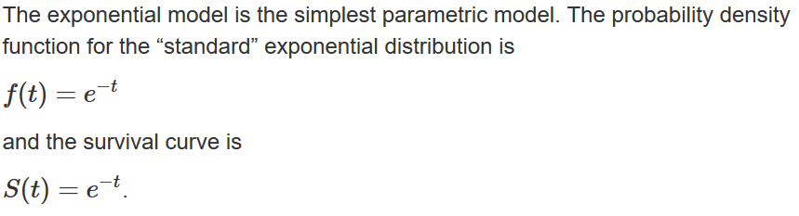
The exponential distribution
The “standard” exponential distribution.

Slide 4
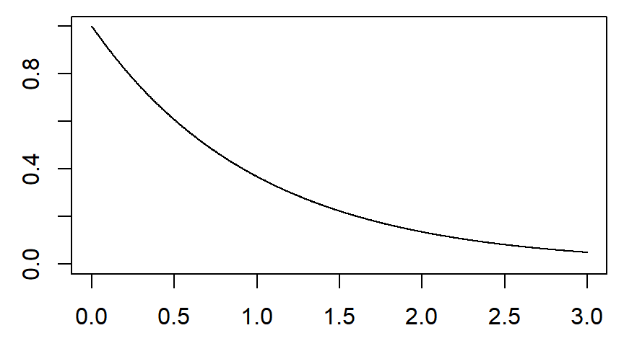
Survival curve for the “standard” exponential

Slide 5
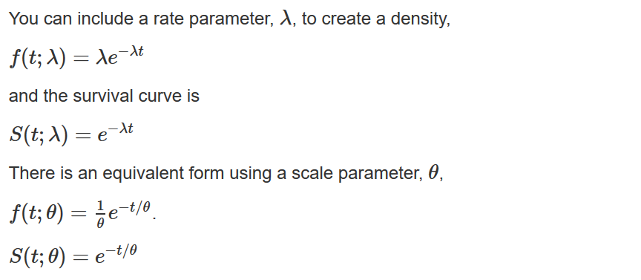
The exponential distribution
The rate and scale parameters.

Slide 6
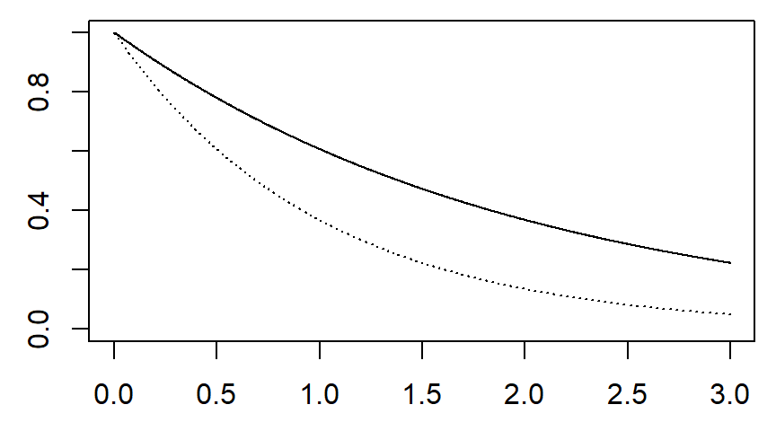
Survival curve for θ=2

Slide 7
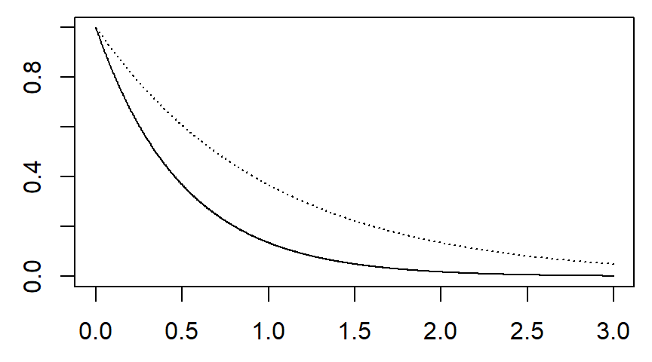
Survival curve for θ=0.5

Slide 8
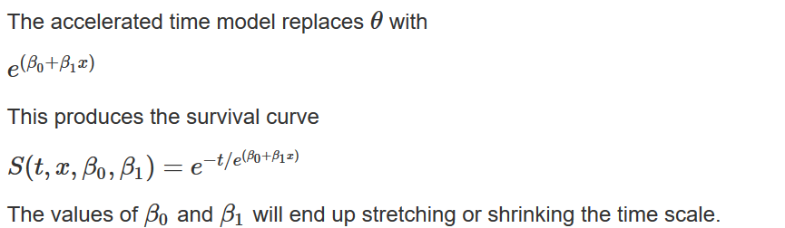
The exponential distribution
The accelerated time model.

Slide 9
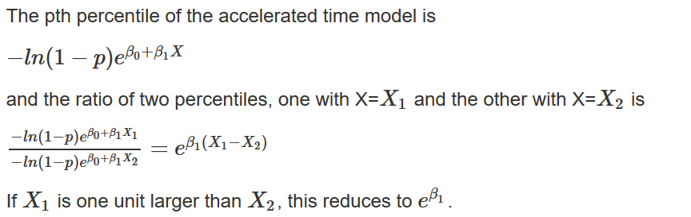
The exponential distribution
Comparison of percentiles.

Slide 10
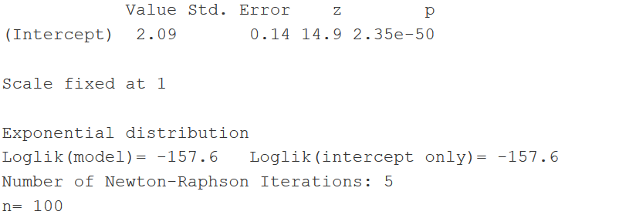
The exponential distribution

Slide 11
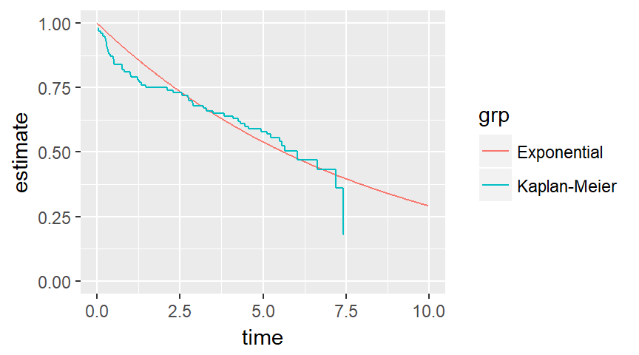
Survival curves (no covariates)

Slide 12
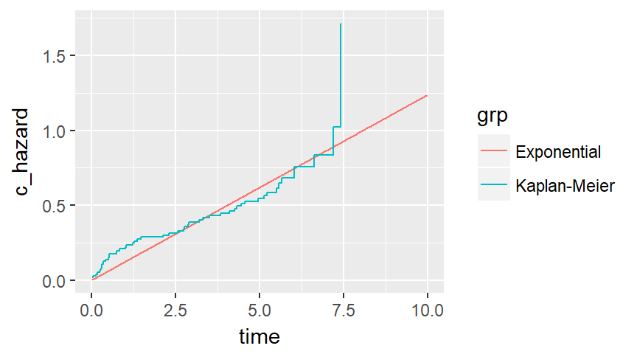
Cumulative hazards (no covariates)

Slide 13
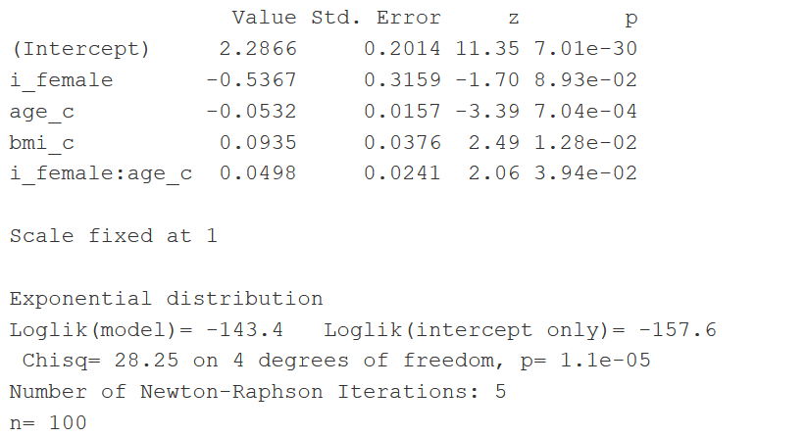
The exponential distribution

Slide 14
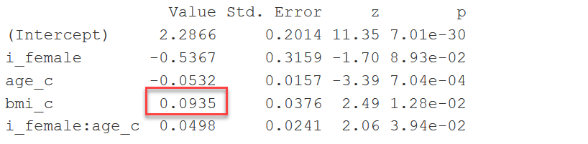
Interpreting the coefficients
Each unit increase in BMI shifts the survival percentiles by a factor of exp(0.093) = 1.098. A five unit shift in BMI shifts the survival percentiles by 1.098^5 = 1.596.

Slide 15
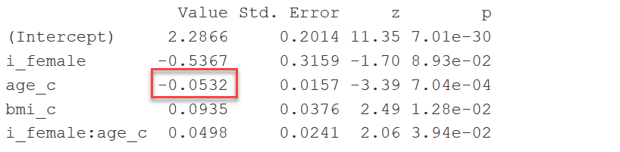
Interpreting the coefficients
Because of the interaction, the effect of age is different for men and women. For men, a one year increase in age will shift the survival percentiles by a factor of exp(-0.053) = 0.948.

Slide 16
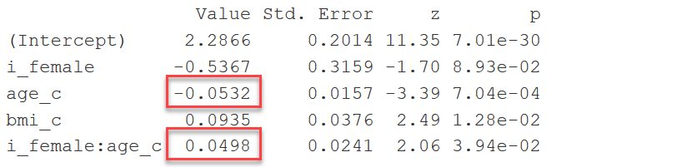
Interpreting the coefficients
For women, a one year increase in age will shift the survival percentiles by a factor of exp(-0.053 + 0.05) = 0.997.

Slide 17
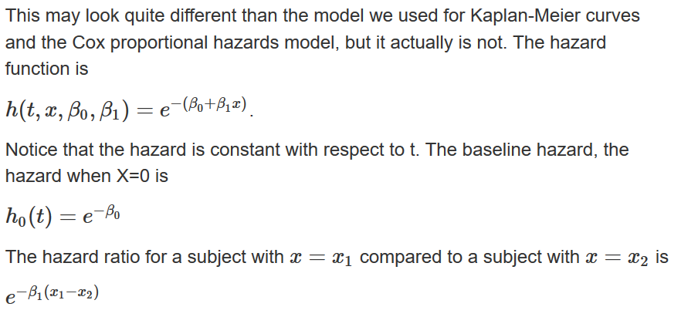
The exponential distribution

Slide 18
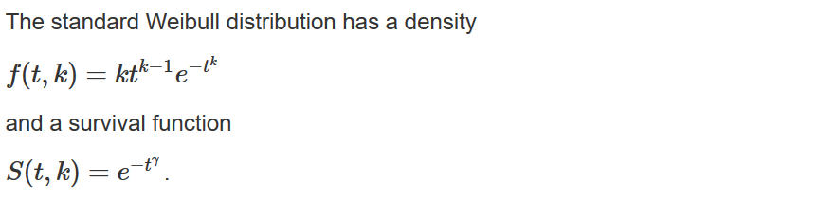
The Weibull distribution

Slide 19
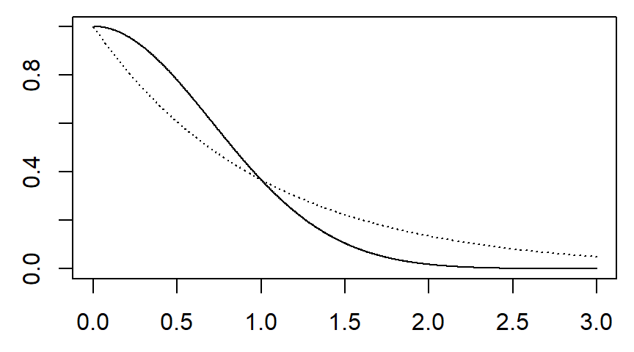
The Weibull distribution (k=2)

Slide 20
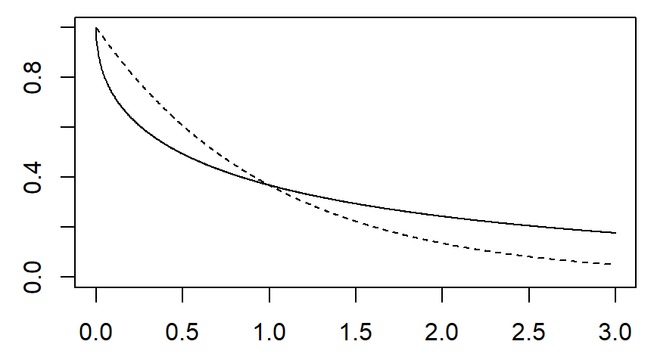
The Weibull distribution (k=0.5)

Slide 21
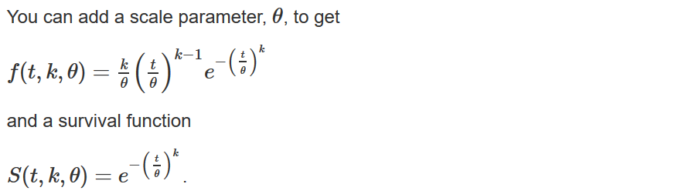
The Weibull distribution

Slide 22
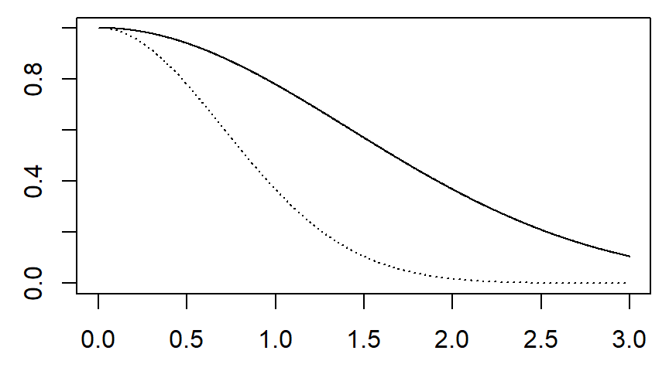
The Weibull distribution (θ=2)

Slide 23
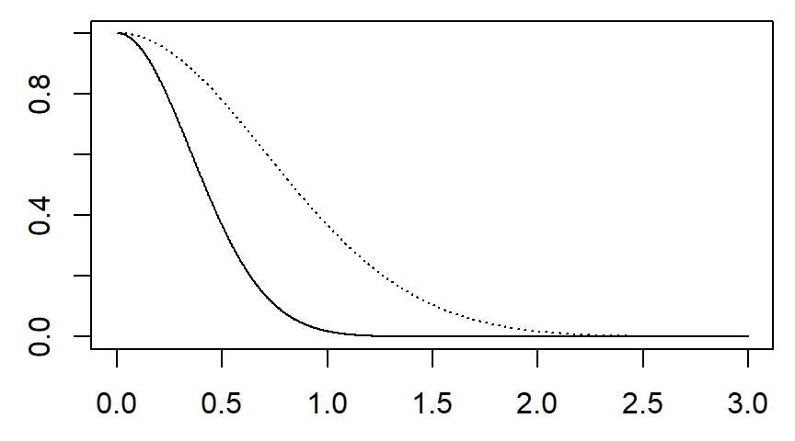
The Weibull distribution (θ=0.5)

Slide 24
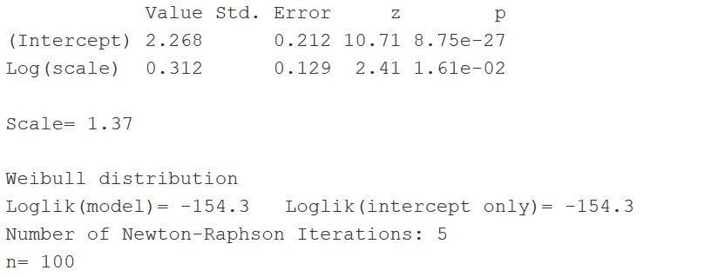
First, fit a null Weibull model

Slide 25
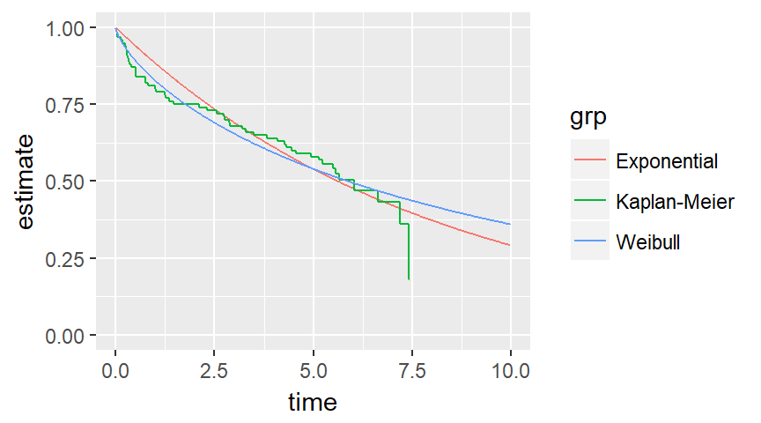
First, fit a null Weibull model

Slide 26
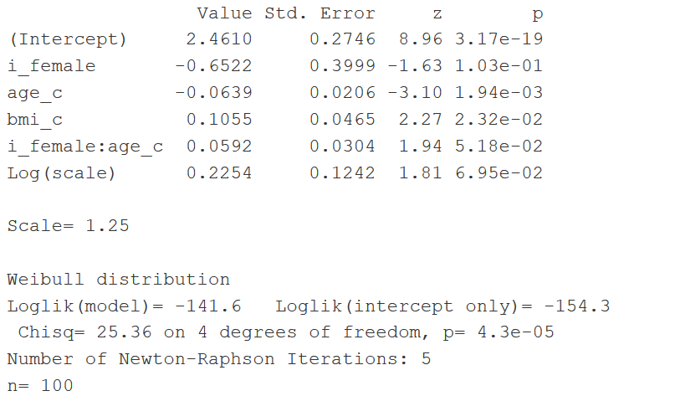
The Weibull model

Slide 27
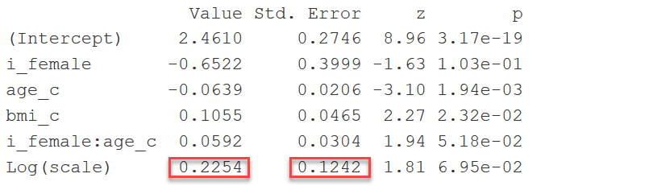
Interpreting the coefficients
The 95% confidence interval for the scale parameter is
exp(0.225 +/- 1.96*0.124) or 0.982 to 1.598.

Slide 28
The Weibull model

Slide 29
Conclusion
What have you learned today?
The exponential and Weibull regression models fit a parametric survival curve to the data.
You can interpret both models in terms of accelerated time.
The exponential survival curve is associated with a constant hazard.
The Weibull survival curve is associated with
a decreasing hazard if the scale parameter is less than one,
a constant hazard if the scale parameter equals one, and
an increasing hazard if the scale parameter is greater than one.

